Slide 1
Unit-3
3.9 Use Case Diagrams
1

Slide 2
Introduction
Getting started is the most difficulty part of any new process.
In software modelling, the first thing you need to do is understand what are you going to model and ultimately develop.
Creating a highest form details about a system-
-use case diagram--is an almost natural point of origin for the software design.
A use case diagram is an excellent way to communicate to management, customers, and other non-development people what a system will do when it is completed.

Slide 3
University Record System (URS)
A University record system should keep information about its students and academic staff.
Records for all university members are to include their id number, surname, given name, email, address, date of birth, and telephone number.
Students and academic staff each have their own unique ID number: studN (students), acadN (academic employee), where N is an integer (N>0).
In addition to the attributes mentioned above:
Students will also have a list of subjects they are enrolled in. A student cannot be enrolled in any more than 10 subjects.
Academic employees will have a salary, and a list of subjects they teach. An academic can teach no more than 3 subjects.

Slide 4
Some Actions Supported by URS
The system should be able to handle the following commands.
Add and remove university members (students, and academic staff)
Add and Delete subjects
Assign and Un-assign subjects to students
Assign and Un-assign subjects to academic staff.

Slide 5
Use Case Diagrams
Use Case diagrams show the various activities the users can perform on the system.
System is something that performs a function.
They model the dynamic aspects of the system.
Provides a user’sperspective of the system.

Slide 6


Use Case Diagram - URS System
URS
add member
system user
del member
add subject
academic
del subject
assg subject unass subject enrol subject
student
unenrol subject

Slide 7
Use Case Diagrams
A set of ACTORS: roles users can play in interacting with the system.
An actor is used to represent something that users our system.
A set of USECASES: each describes a possible kind of interaction between an actor and the system.
Uses cases are actions that a user takes on a system
A number of RELATIONSHIPSbetween these entities (Actors and Use Cases).
Relationships are simply illustrated with a line connecting actors to use cases.

Slide 8
Use Case Diagrams - Actors
An actor is a user of the system playing a particular role.
Actor is shown with a stick figure.
employer
employee
client

Slide 9
Use Case Diagrams – Use Cases
Use case is a particular activity a user can do on the system.
Is represented by an ellipse.
Following are two use cases for a library system.
Borrow
Reserve

Slide 10

Use Case Diagram – Example1 (Library)
library system
borrow
client
employee
reserve
Order title
Fine payment
supervisor
A Library System.
10

Slide 11

Use Case Diagram for Student Assessment Management System
Grade system
Record grades
Student
View grades
Teacher
Distribute Report cards
Create report cards
Printing administrator

Slide 12
Use Case Vs Scenarios
Each use case is one or more scenarios.
Add Subject Use Case :
Scenario 1 : Subject gets added successfully.
Scenario 2 : Adding the subject fails since the subject is already in the database.
Enroll Subject Use Case:
Scenario 1 : Student is enrolled for the subject.
Scenario 2 : Enrollment fails since the student is already enrolled in the subject.
Each scenario has a sequence of steps.

Slide 13
Scenarios
Each scenario has a sequence of steps.
Scenario 1 : Student is enrolled for the subject.
Student chooses the “enroll subject” action.
Check the student has enrolled in less than 10 subjects.
Check if the subject is valid.
Assign the subject to the student.

Slide 14
Scenarios
Each scenario has a sequence of steps.
Scenario 2 : Enrolling fails since the student is already enrolled in 10 subjects.
Student chooses the “enroll subject” action.
Check the student has enrolled in less than 10 subjects.
Return an error message to the student.

Slide 15
Use Case Diagrams - Relationships
Inclusion
Inclusionenablestoreuseoneusecase'ssteps
insideanotherusecase.
Extension
Allowscreatinganewusecasebyaddingstepsto existingusecases
Generalization
Allowschildusecasestoinheritbehaviorfrom
parentusecases

Slide 16



Use Case – Example (self service machine)
Self service machine
Buy a product
Self service machine
customer
Collect Money
Collector
Self service machine
Restock
Supplier

Slide 17
Use Case – Example (self service machine
– includes relationship)
<<includes>>
Open Machine
Restock
<<includes>>
Close Machine
<<includes>>
Open Machine
Collect
<<includes>>
Close Machine

Slide 18
Use Case – Example (self service machine
– extends relationship)
<<includes>>
Open Machine
Restock
<<includes>>
Close Machine
<<extends>>
Restock According to Sales

Slide 19
Use Case – Example (self service machine – generalize relationship): Actor-to-Actor relationship
generalized actor
Supplier Agent
specialized actor
Restocker
Collector

Slide 20
Use Case – Example (self service machine – generalize relationship): Actor-to-Actor relationship – example 2
generalized actor
Cook
specialized actor
Mom Cook
Father Cook
20

Slide 21
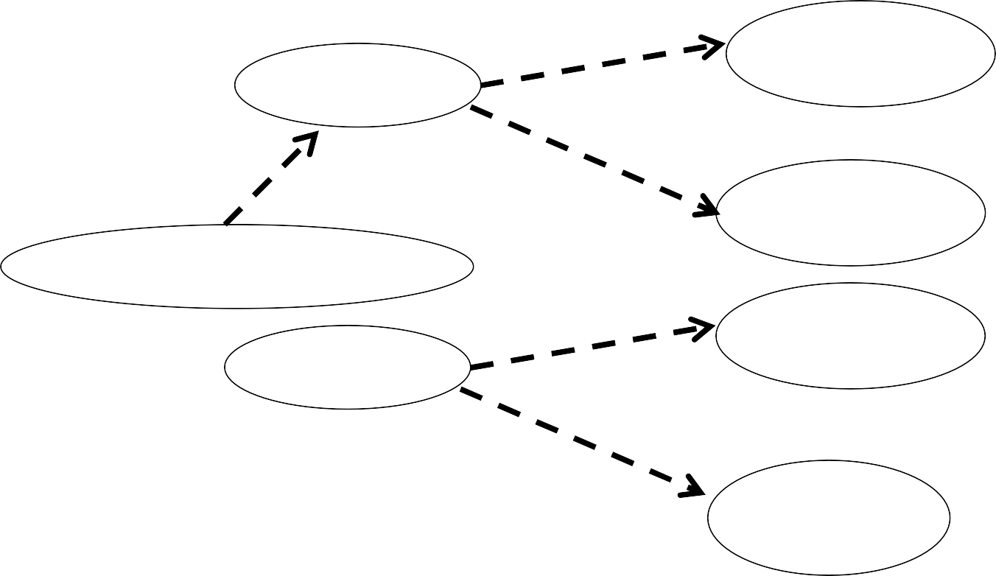

Use Case – Example (self service machine)
Buy a product
Self Service Machine
<<includes>>
customer
Open Machine
Restock
<<includes>>
Restock according to sales
<<includes>>
Collect
Close Machine
Open Machine
supplier
<<includes>>
Close Machine
21

Slide 22
From Use Case to Classes
22

Slide 23
Identify Classes (Extract Nouns)
A University record system should keep information about its students and academic staff.
Records for all university members are to include their id number, surname, given name, email, address, date of birth, and telephone number.
■
Students and academic staff each have their own unique ID number: studN (students), acadN (academic employee), where N is an integer (N>0).
In addition to the attributes mentioned above:
Students will also have a list of subjects they are enrolled in. A student cannot be enrolled in any more than 10 subjects. Academic employees will have a salary, and a list of subjects
they teach. An academic can teach no more than 3 subjects.
■

Slide 24
Nouns which are potential classes
A Universityrecordsystemshould keep information about its studentsand academicstaff.
Records for all universitymembersare to include their id number, surname, given name, email, address, date of birth, and telephone number.
■
Students and academic staff each have their own unique ID number: studN (students), acadN (academic employee), where N is an integer (N>0).
In addition to the attributes mentioned above:
Students will also have a list of subjectsthey are enrolled in. A student cannot be enrolled in any more than 10 subjects.
Academic employees will have a salary, and a list of subjects they teach. An academic can teach no more than 3 subjects.
■

Slide 25
Classes identified in the first pass
UniversityRecordSystem - URS
Student
Academic Staff
UniversityMembers
Subject

Slide 26
URS - High Level Class Diagram
URSDataBase
1
1
has
*
has
*
UniversityMember
Subject
0…10
0..3
AcademicStaff
Student
takes
*
1
teaches

